Slide 1
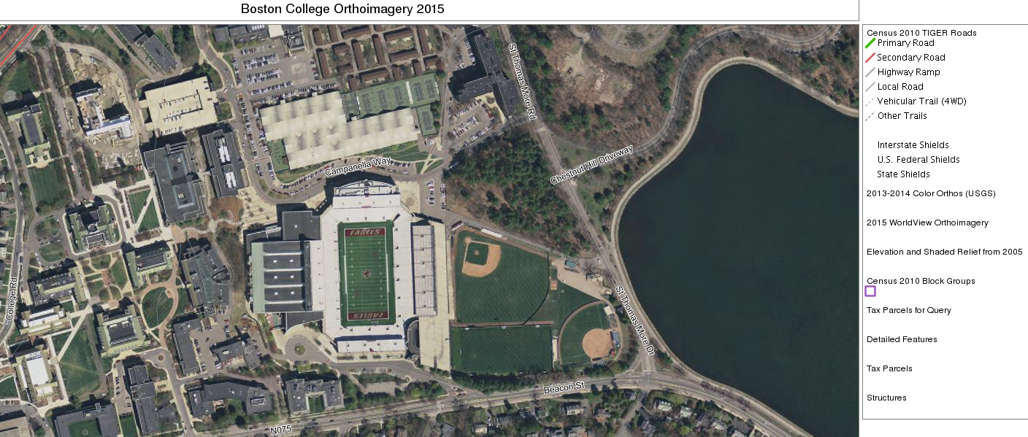
Geographic Information Systems and Spatial Thinking
Barbara Mento : barbara.mento@bc.edu
Fall 2018

Slide 2
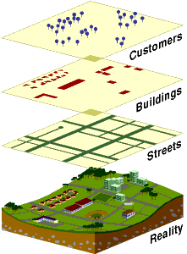
What is GIS?
Geographic Information System (GIS) is a software tool used to: Visualize
Question
Analyze Interpret data to understand relationships, patterns, and trends.
Thinking Spatially “It's really combining the idea of where things are and why they're there, so the spatial component, with the art. And it's really about communication, so finding a way to communicate those spatial phenomena in a way that resonates with people and better helps them understand. “Edie Punt
ESRI
Source: http://www.coastalwiki.org/wiki/File:GISdefinition.jpg#filehistory

Slide 3
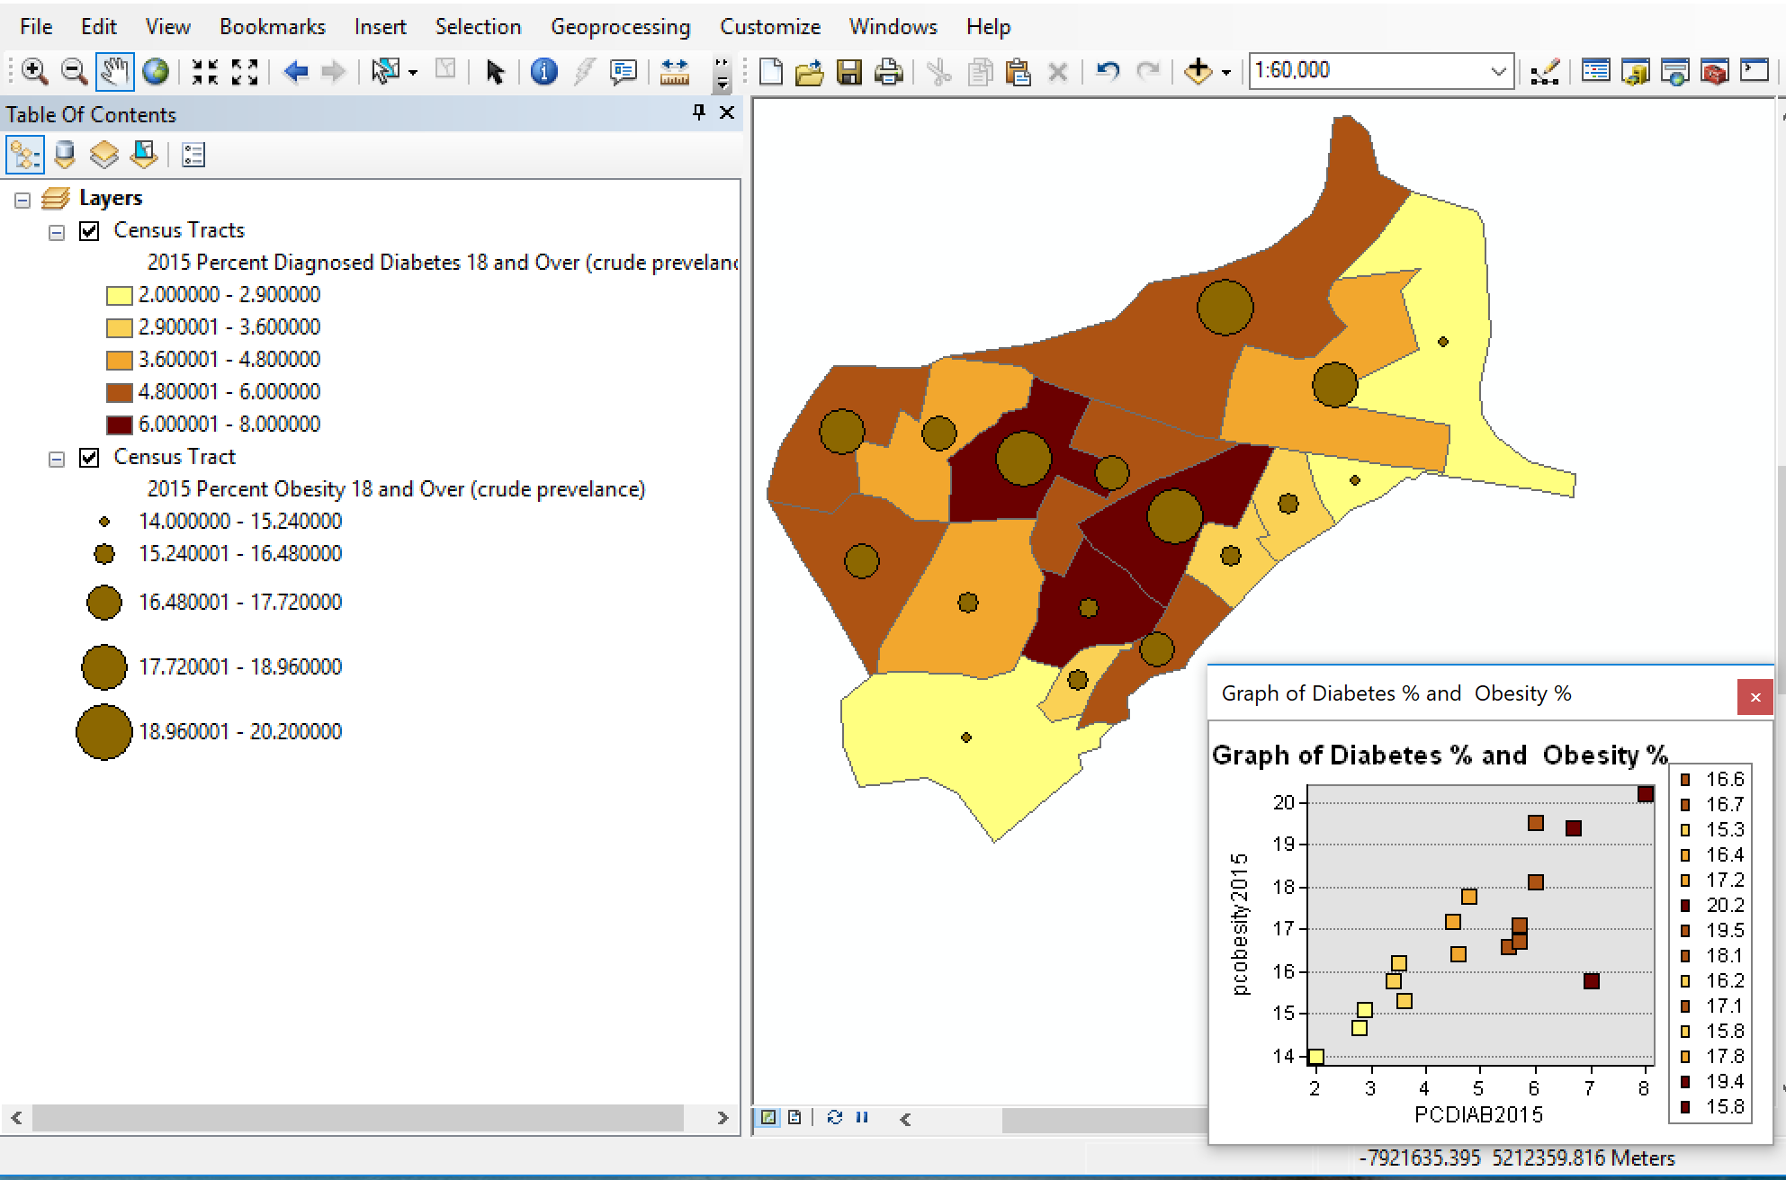
Applications: Social Sciences
Explore correlation between Obesity and Diabetes rates

Slide 4
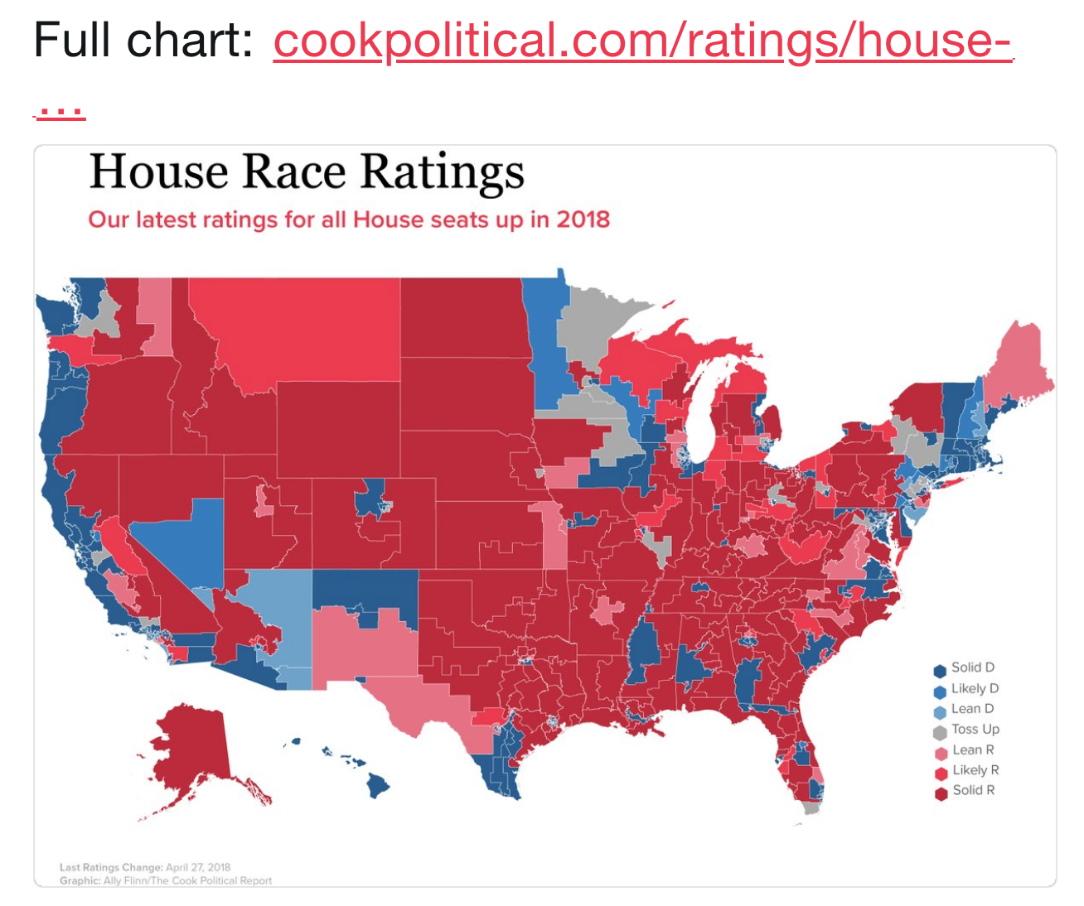
Applications: Social Sciences
Examine House Race Ratings by the Cook Political Report
https://twitter.com/cookpolitical/status/989931275774496769

Slide 5
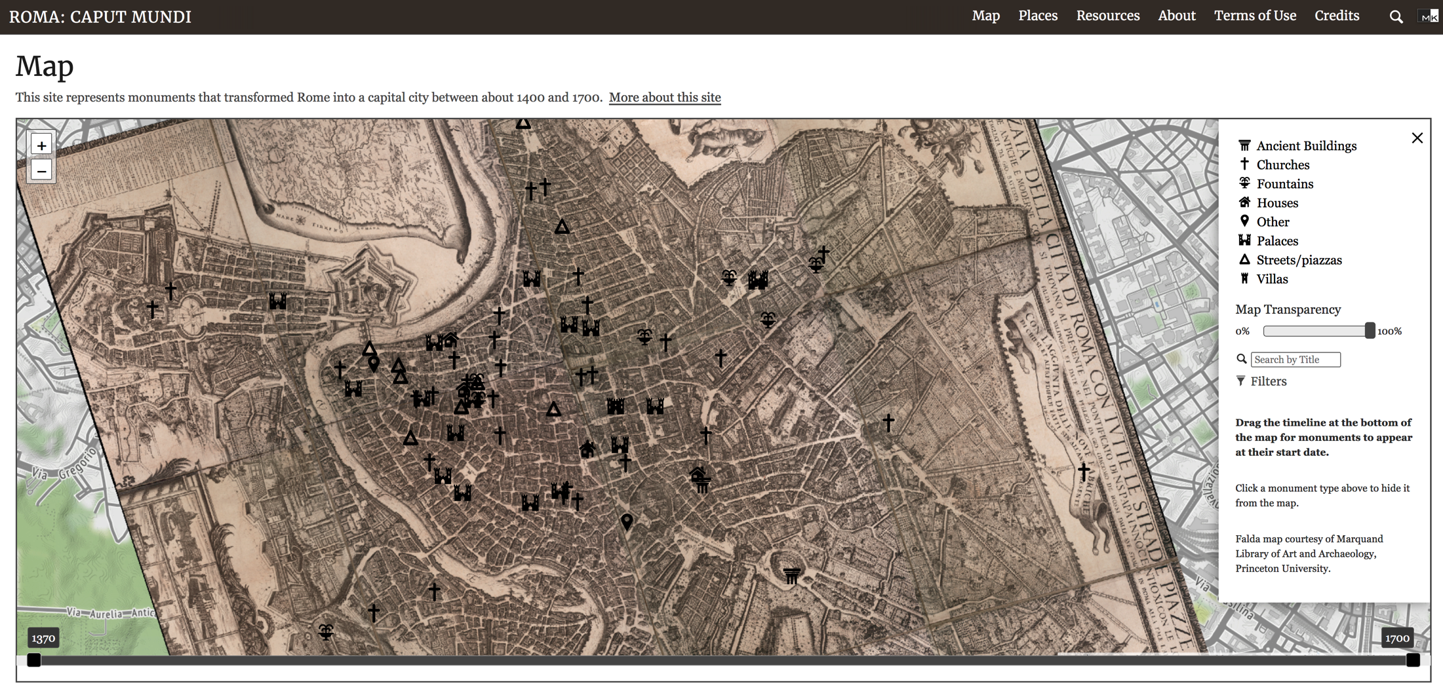
Applications: Humanities
Georectify historical maps and add georeferenced data
Roma :Caput Mundi project Stephanie Leone, Art History

Slide 6
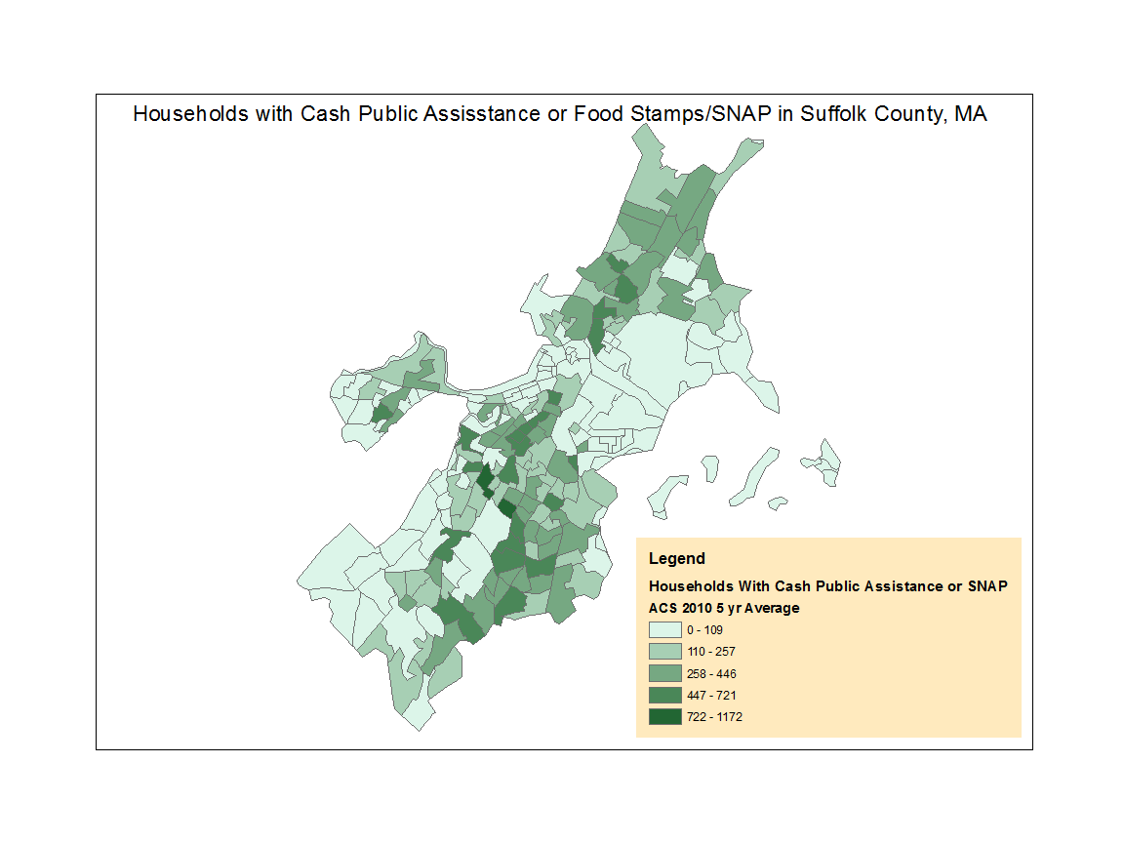
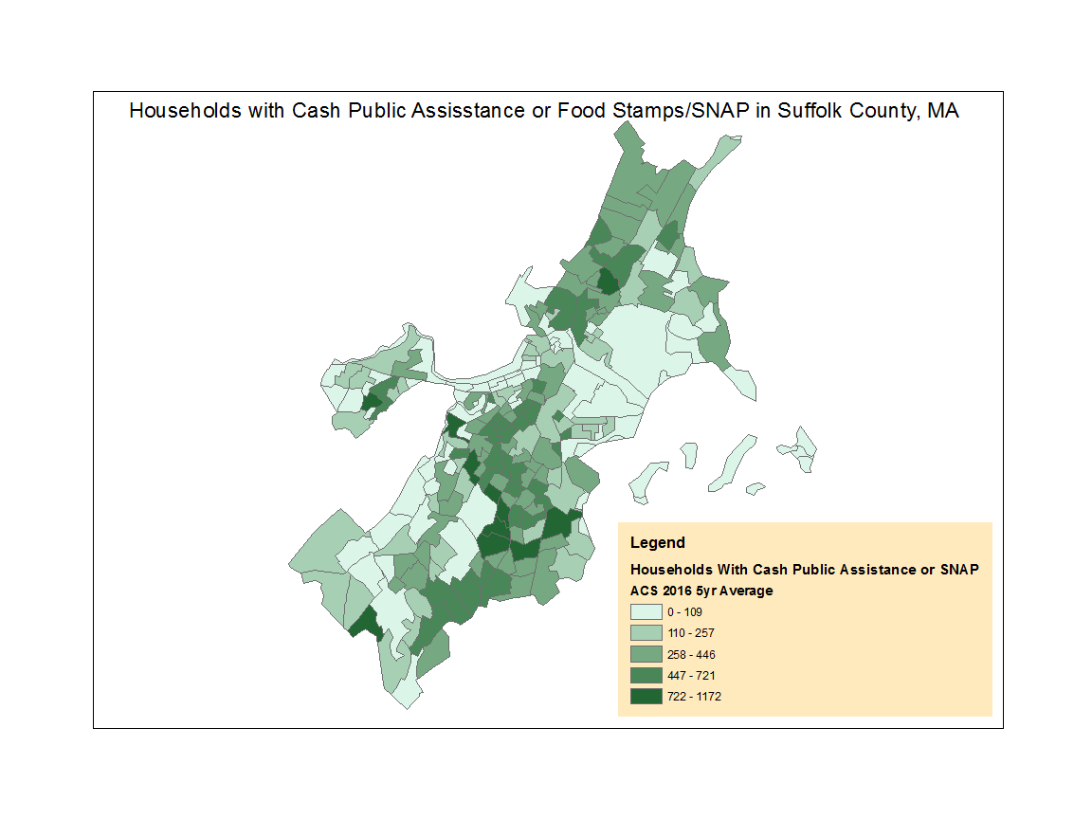
Application: Social Sciences
Trends for Suffolk County Households with Food Stamps/SNAP by Census Tract

Slide 7
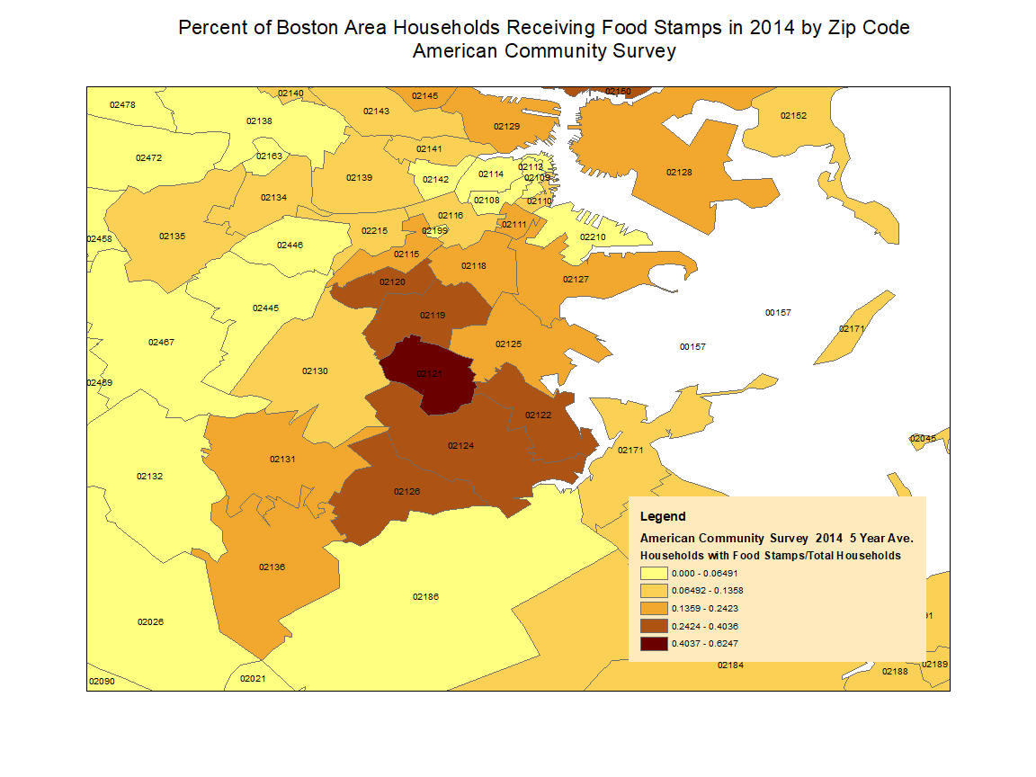
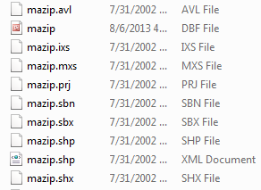
Data Structures Key Concepts and Terms
Shapefile: Geographic features in a shapefile can be represented by points, lines, or polygons (areas). Right polygons for zip codes from shapefiles below.
Notes:
Shapefile - A shapefile is a simple, nontopological format for storing the geometric location and attribute information of geographic features. Geographic features in a shapefile can be represented by points, lines, or polygons (areas).
Layer - A GIS utilizes a layer-based geographic information model for characterizing and describing our world.
Attributes and descriptive information - These are traditional tabular information used to describe features and categories about the geographic objects within each dataset.
Geocoding - Geocoding is the process of transforming a description of a location—such as a pair of coordinates, an address, or a name of a place—to a location on the earth's surface. You can geocode by entering one location description at a time or by providing many of them at once in a table.
Three fundamental representations of geographic information layers Points, lines, and polygons.
Geographic features are representations of things located on or near the surface of the earth. Geographic features can occur naturally (such as rivers and vegetation), can be constructions (such as roads, pipelines, wells, and buildings), and can be subdivisions of land (such as counties, political divisions, and land parcels).
Missing Data - Feature datasets with missing values should be treated with care. If missing values are represented by a code (for example, -99), all the statistical analysis based on that data will be wrong

Slide 8
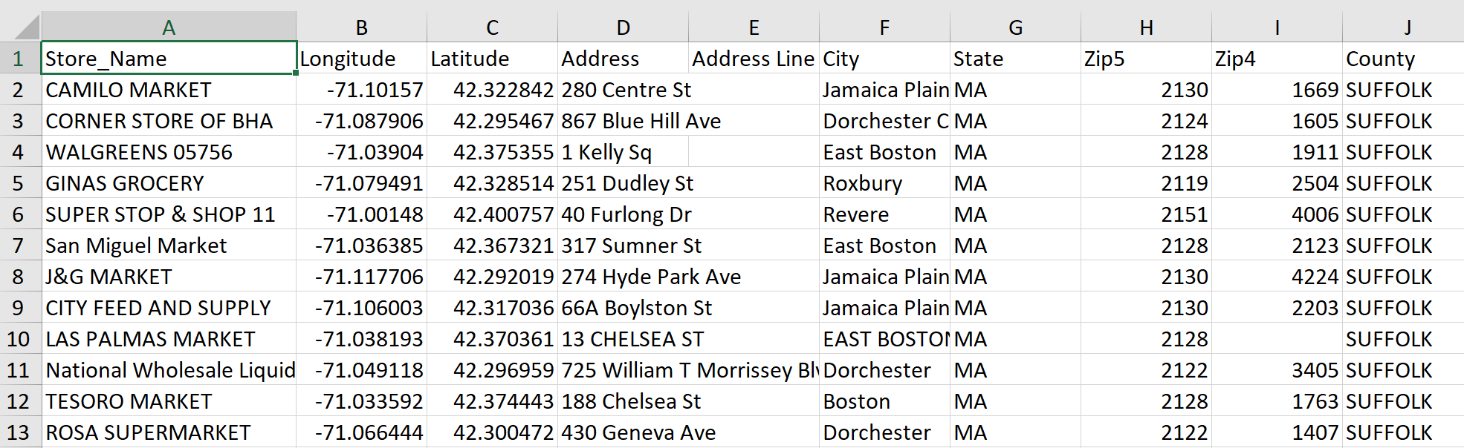
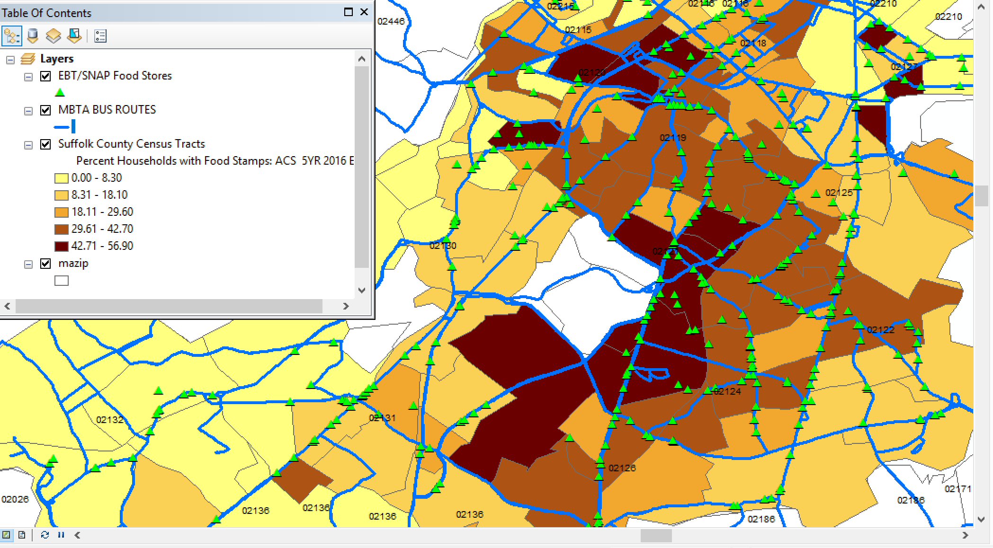
Data Structures Feature types
GIS utilizes a layer-based geographic information model for characterizing and describing our world.
Points: longitude, latitude (right data)
Lines: roads, bus routes
Polygons: boundaries such as
Zip codes, land plots, bodies of water

Slide 9
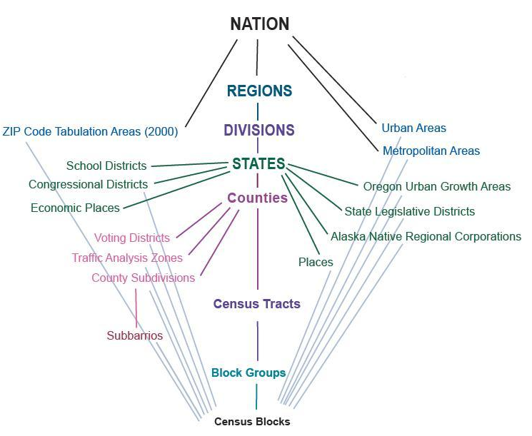
Open Access Polygons and Data for U.S.
Open access data is available from U.S. via the Census site American FactFinder and internationally from agencies such as World Bank.
Geographic areas vary by country.
Right: Standard Hierarchy of Census Geographic Entries

Slide 10
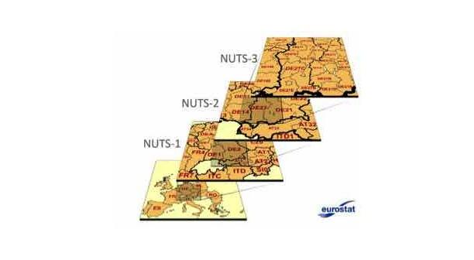
International Boundaries: Eurostat classification
International boundaries vary by country and source. The are sources listed on the GIS research guide.
This is an example of one source for Eurostat.
The NUTS classification (Nomenclature of territorial units for statistics) is a hierarchical system for dividing up the economic territory of the EU for the purpose of:
Socio-economic analyses of the regions
NUTS 1: major socio-economic regions
NUTS2: basic regions for the application of regional policies
NUTS 3: small regions for special diagnoses
Eurostat classification

Slide 11
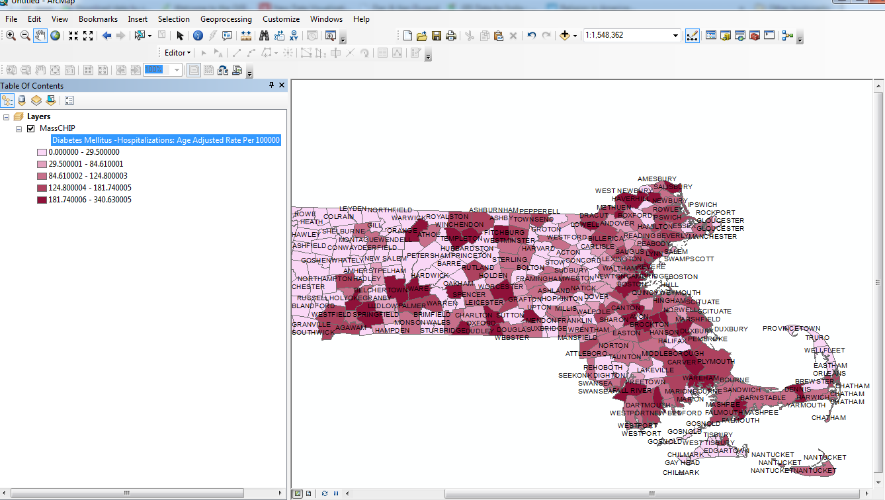
Data Structures
Attributes and descriptive features: Tabular information used to describe features linked to the feature by a unique geographic identifier. Important when collecting data to record unique geocode. Date created in spreadsheet compatible format.
Right: town polygons with incidence of
hospitalization for various health
issues.

Slide 12
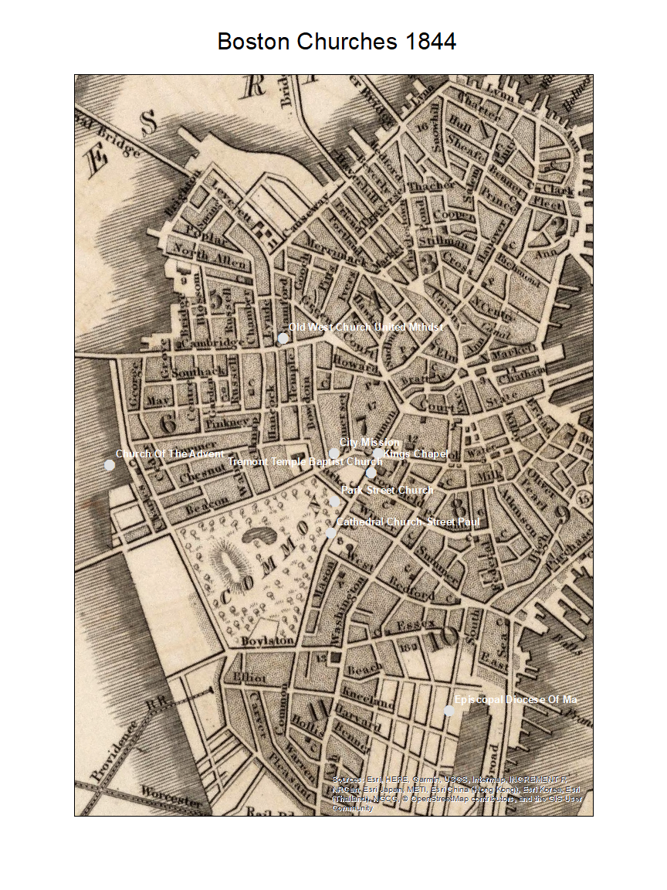
Additional Concepts
Georectification
The digital alignment of a satellite or aerial image with a map of the same area. In georectification, a number of corresponding control points, such as street intersections, are marked on both the image and the map. These locations become reference points in the subsequent processing of the image.

Slide 13
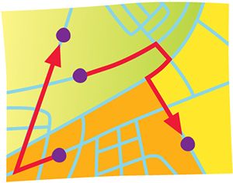
Data Models
Vector
A coordinate-based data model that represents geographic features as points, lines, and polygons. Each point feature is represented as a single coordinate pair, while line and polygon features are represented as ordered lists of vertices. Attributes are associated with each vector feature, as opposed to a raster data model, which associates attributes with grid cells.
ESRI Data Dictionary

Slide 14
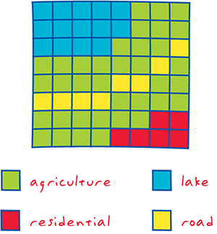
Data Models
Raster
A spatial data model that defines space as an array of equally sized cells arranged in rows and columns, and composed of single or multiple bands. Each cell contains an attribute value and location coordinates. Unlike a vector structure, which stores coordinates explicitly, raster coordinates are contained in the ordering of the matrix. Groups of cells that share the same value represent the same type of geographic feature. coordinate system
Esir Data Dictionary

Slide 15
GIS Data Considerations
Geocode: A code representing the location of an object, such as an address, a census tract, a postal code, or x,y coordinates. There are tools for geocoding data.
Format: Data complied in spreadsheet compatible format, generally .csv or .xls.
Cells: Zip codes require leading zeros that are deleted by Excel unless cell is customized. Cell formatting important for numbers. Consider treatment of missing data such as filling in blank cells with zeros.
(ArcGIS 10 Help Library Fundamentals)

Slide 16
Spatial Information Literacy for Instruction
SIMPLE | COMPLEX
Location | Distribution
Distance | Patterns
Direction | Clustering
Boundaries | Density
Shapes | Buffer
Symbols | Scale
Adapted From: Golledge, et al 2008 / adapted by Jo & Bednarz, 2009 / Frameworks Table1 in Mohan and Mohan (2013) Spatial Thinking About Maps: Development of Concepts and Skills Across the Early Years and from Sinton (2011)

Slide 17
GIS Software
Licensed GIS software at Boston College
ArcGIS
Available in locations across campus including O’Neill Library and department labs. May be installed on laptops, but Mac platforms require Bootcamp to run Windows.
Also available on local server at bcapps.bc.edu
Contact :Constantin Andronache constantin.andronache@bc.edu
QGIS
Available for free download (see GitHub instructions) and also in Digital Studio on the second floor of O’Neill.

Slide 18
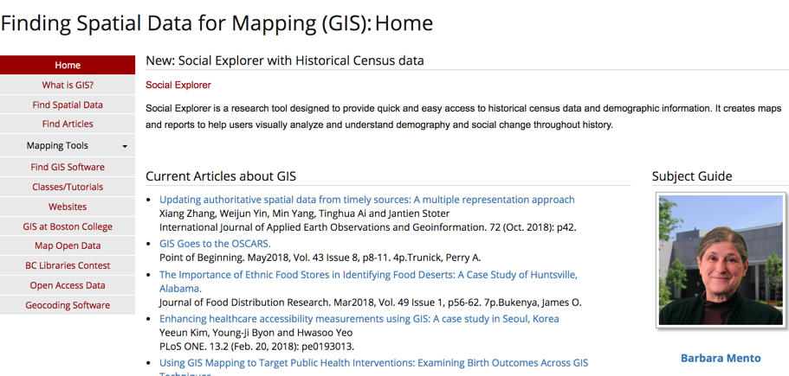
GIS Resources
Boston College has purchased GIS data, primarily Census and Business Data.
Many government agencies and research organizations, such as MassGIS, provide free access to government images and data.
Other government agencies and commercial sites offer free mapping interfaces.
http://libguides.bc.edu/gis

Slide 19
GIS Mapping Contest!
Students are invited to present their GIS Mapping work as part of a campus-wide celebration of geospatial research at Boston College.
Spring 2019
Contest details will be at this url in the Fall:
https://libguides.bc.edu/gis/contestinfo
Please encourage your students to participate!

